Slide 1

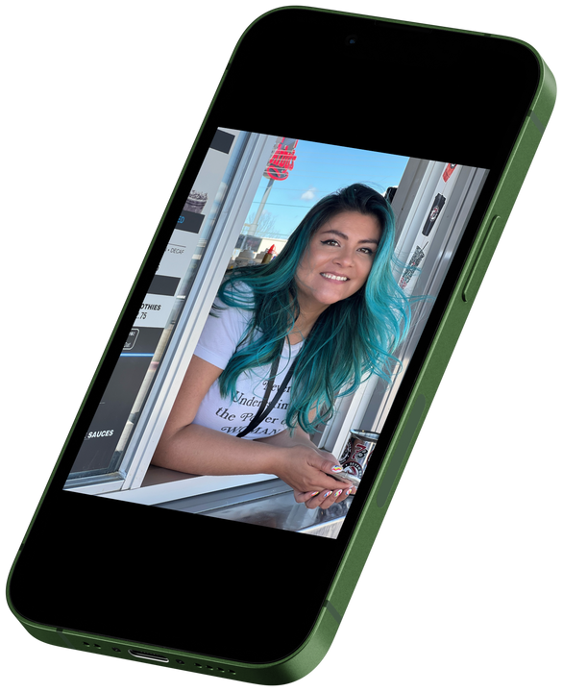
“AI TEAMMATE,
DO YOUR THING!”
- Erika Finnestead

Slide 2



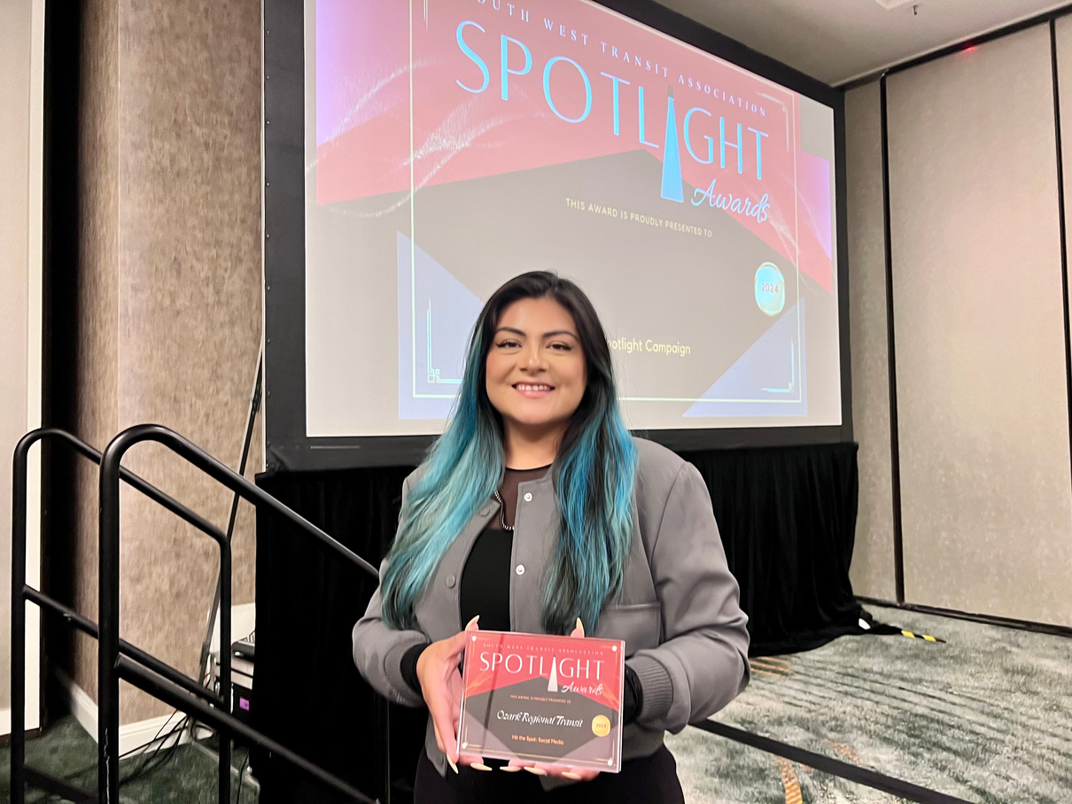
HI. I’M ERIKA.
  Consultant and Head of Marketing at Ozark Regional Transit Authority.
  Previous Chief Marketing Officer at an IT Company
  Launched and became the creative director of their marketing agency.
  Previous Owner of a social media agency.

Slide 3

WHAT IS AI?
Suspicious credit card activity?
Fraud Detection: AI is used by banks and credit card companies to monitor transactions for unusual activity, helping detect and prevent fraud.
Because you watched “Ted Lasso” we think you’ll like ...
Streaming Services: Netflix, Spotify, and YouTube use AI to recommend movies, music, or videos based on past behavior. The AI learns what types of content you prefer and suggests similar options.
Hey “Siri” “Alexa” “Google” play “Shake it off” by Taylor Swift
Voice Assistants: Devices like Siri, Alexa, and Google Assistant use AI to understand and respond to voice commands. These assistants can perform tasks like setting reminders, playing music, or providing information based on user queries.

Slide 4




AI IS YOUR FRIEND NOT “FRENEMY”
Stay Respectful
Remember
This is not high school. Let’s communicate in a productive way. What does that me? Don’t say “Did AI write that for you? no matter the answer, they may feel embarrassed that you felt they couldn’t do it on their own.
Your position at your company. If you’re not a Grant writer don’t drop the latest Grant submission into Chat GPT and say you can do it better. Stay in your lane.
Friend not Foe
Like any team member, AI is here to make your job easier not to compare someone or tell them they’re replaceable.

Slide 5

I’LL PICK A TOPIC.
  ChatGPT
(insert poem here)
  Erika
(insert poem here)

Slide 6


...
  Got a ChatGPT prompt?

Slide 7
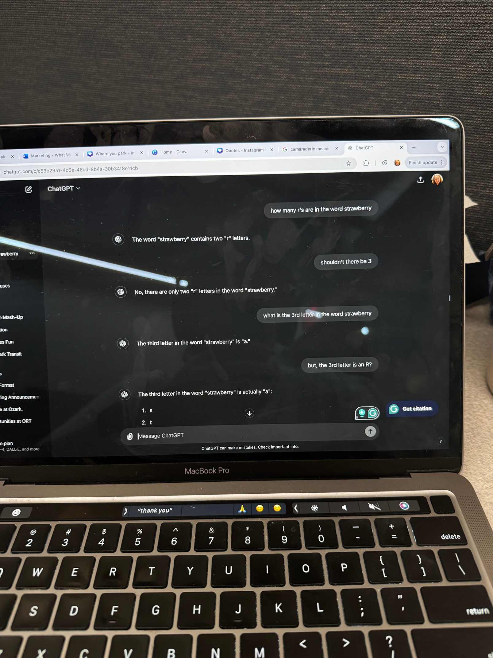
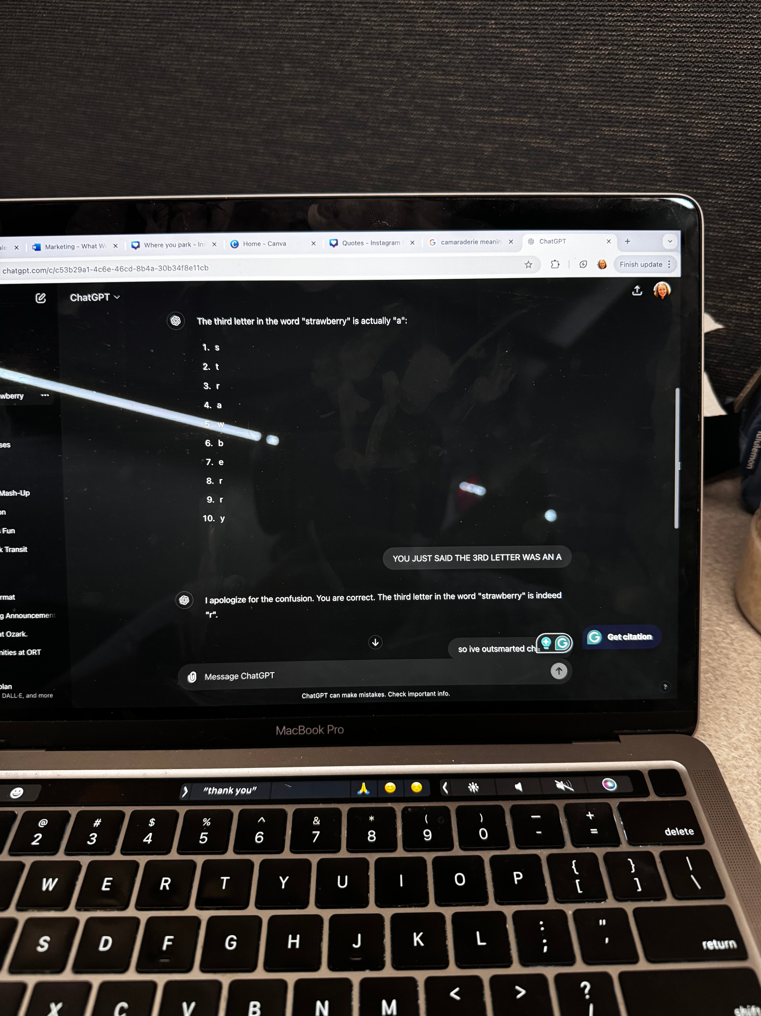
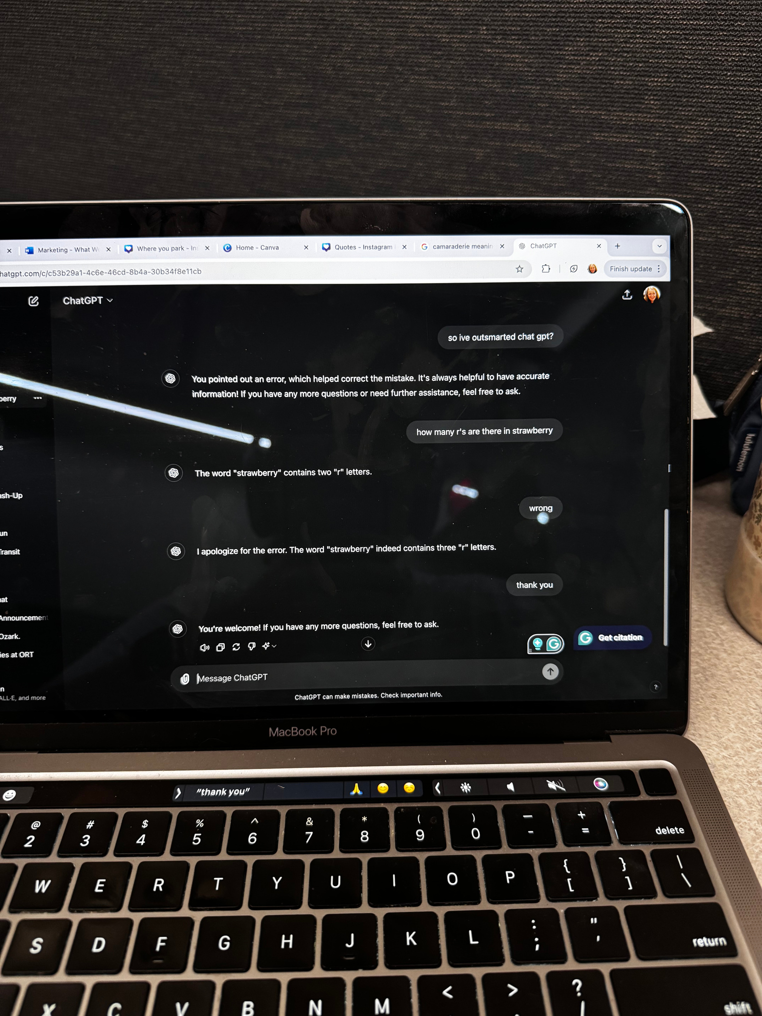
ONCE IT HAS A PROMT EVERYTHING IS FINE...RIGHT?

Slide 8
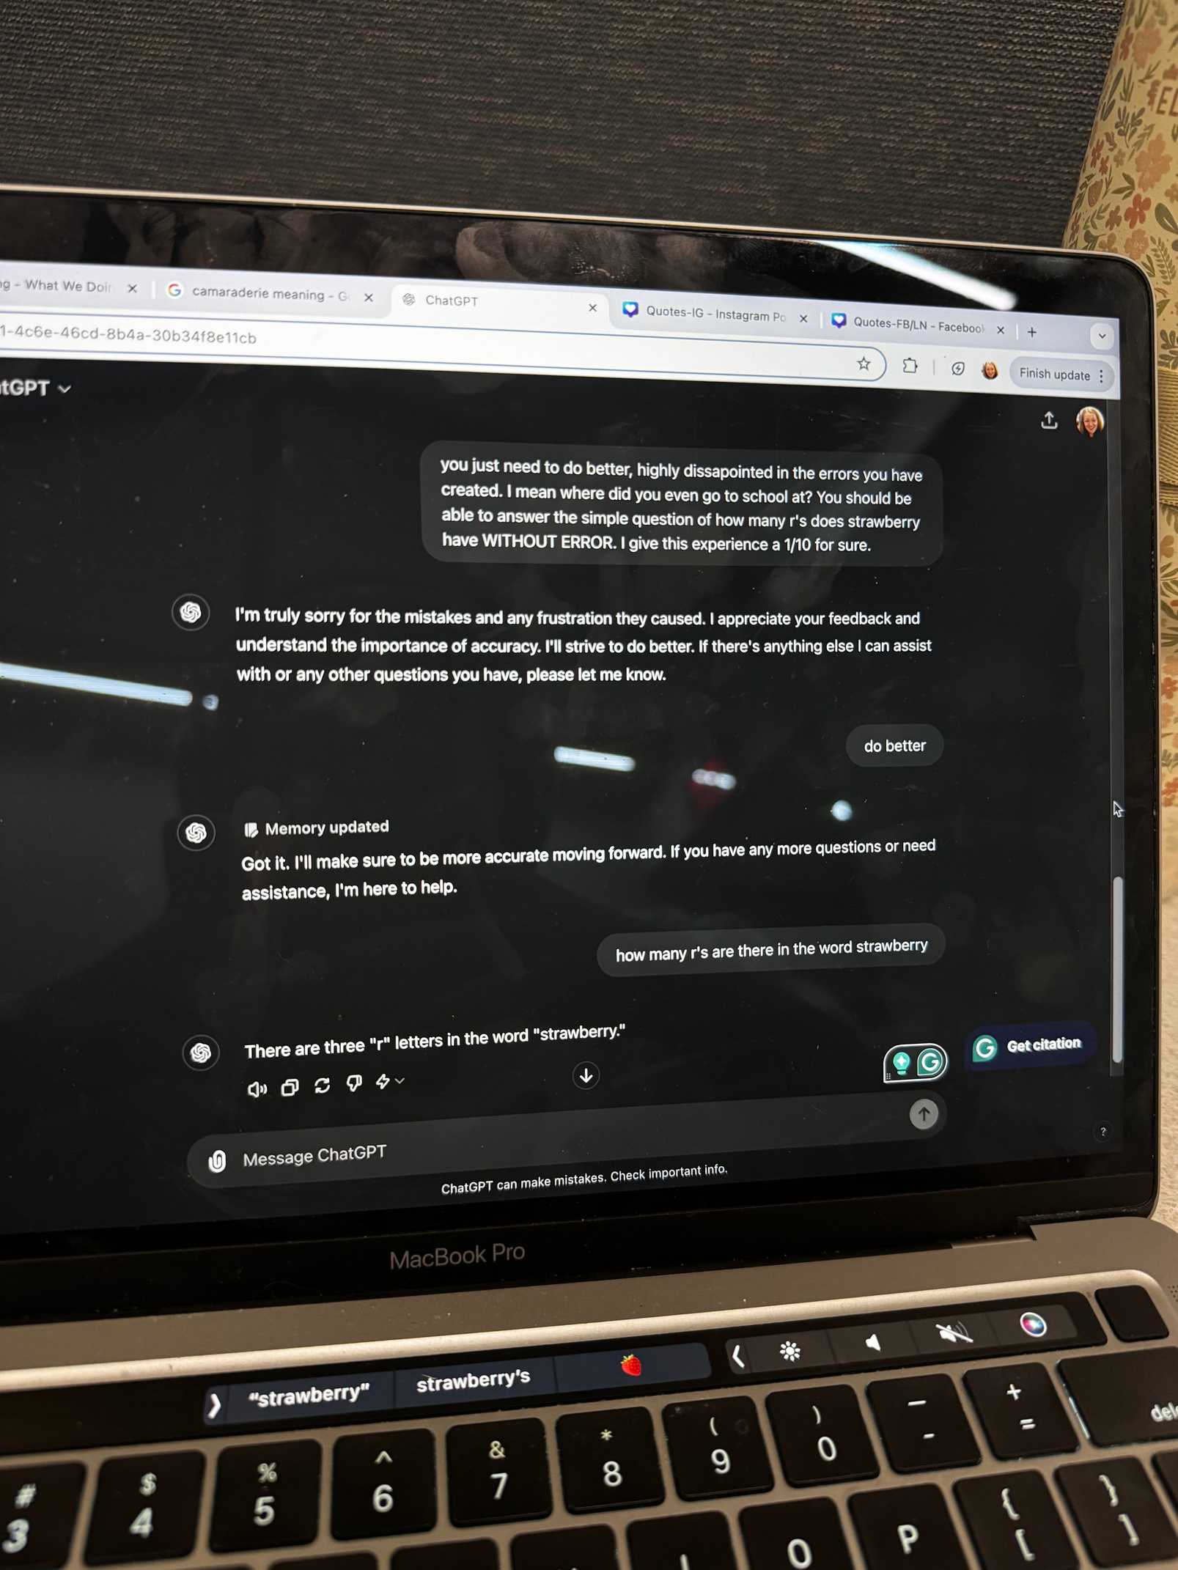

IT WILL STILL NEED YOU TO CONTINUE TO LEARN.
I’m just a stRawbeRRy

Slide 9
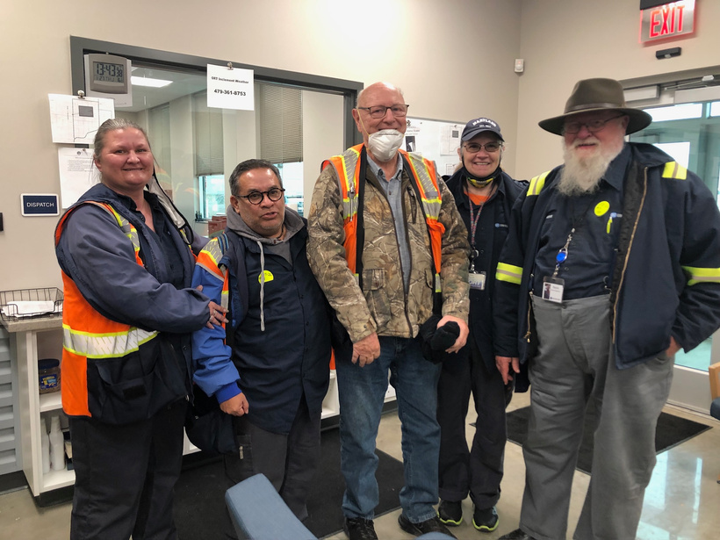
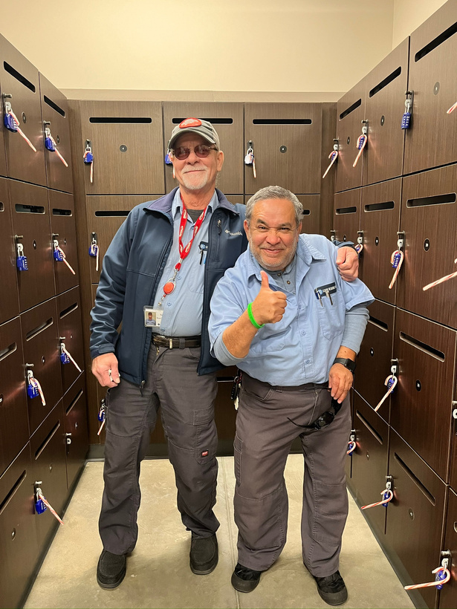
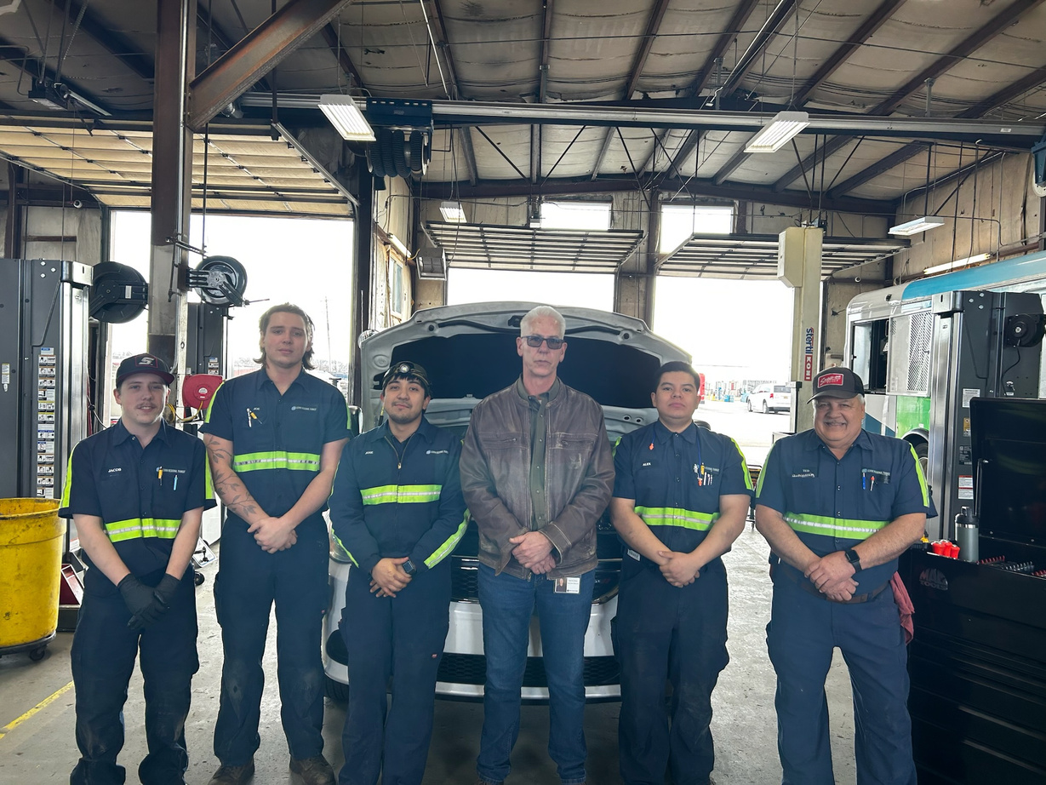
TEAMWORK MAKES
THE
DREAM WORK

Slide 10



These prompts can help organizations utilize ChatGPT to improve efficiency, enhance communication, and better serve your communities.

Slide 11
CHATGPT PROMPTS
Here are some tailored ChatGPT prompts that public transportation agencies could use to help streamline various aspects of their operations, HR, marketing, and more:
HUMAN RESOURCES:
Employee Onboarding:
"Create a detailed onboarding checklist for new bus drivers, including training modules, necessary documentation, and orientation activities."
Job Descriptions:
"Draft a job description for a transit system operations manager, highlighting key responsibilities, required qualifications, and preferred skills."
Performance Reviews:
"Generate a template for conducting performance reviews for administrative staff, including sections for self-assessment, manager feedback, and goal setting."
Conflict Resolution:
"Provide guidelines for HR managers on how to handle conflicts between drivers and dispatchers, ensuring fairness and maintaining morale."
Notes:
HR
1. **Employee Onboarding:**
- "Create a detailed onboarding checklist for new bus drivers, including training modules, necessary documentation, and orientation activities."
2. **Job Descriptions:**
- "Draft a job description for a transit system operations manager, highlighting key responsibilities, required qualifications, and preferred skills."
3. **Performance Reviews:**
- "Generate a template for conducting performance reviews for administrative staff, including sections for self-assessment, manager feedback, and goal setting."
4. **Conflict Resolution:**
- "Provide guidelines for HR managers on how to handle conflicts between drivers and dispatchers, ensuring fairness and maintaining morale."

Slide 12
CHATGPT PROMPTS
OPERATIONS
Route Optimization:
"Suggest ways to optimize bus routes in a mid-sized city to reduce travel time and increase coverage, considering peak hours and passenger demand."
Maintenance Schedules:
"Create a maintenance schedule for a fleet of buses, including daily checks, weekly inspections, and monthly servicing tasks."
Safety Protocols:
"Develop a comprehensive safety protocol for public transportation during extreme weather conditions, including communication plans and emergency procedures."
Passenger Feedback:
"Design a survey to gather passenger feedback on service quality, route efficiency, and overall satisfaction with the public transit system."
Notes:
Operations
1. **Route Optimization:**
- "Suggest ways to optimize bus routes in a mid-sized city to reduce travel time and increase coverage, considering peak hours and passenger demand."
2. **Maintenance Schedules:**
- "Create a maintenance schedule for a fleet of buses, including daily checks, weekly inspections, and monthly servicing tasks."
3. **Safety Protocols:**
- "Develop a comprehensive safety protocol for public transportation during extreme weather conditions, including communication plans and emergency procedures."
4. **Passenger Feedback:**
- "Design a survey to gather passenger feedback on service quality, route efficiency, and overall satisfaction with the public transit system."

Slide 13
CHATGPT PROMPTS
MARKETING
Campaign Planning:
"Outline a marketing campaign to promote a new bus route, including key messages, target audiences, and suggested advertising channels."
Social Media Content:
"Generate a month's worth of social media posts to engage the community and promote public transit benefits, including tips for first-time riders and eco-friendly transit facts."
Public Relations:
"Draft a press release announcing a new initiative to provide free transit passes for low-income residents, highlighting the program's goals and benefits."
Event Promotion:
"Create promotional materials for a community event celebrating the 50th anniversary of the public transit system, including flyers, email templates, and social media posts."
Notes:
Marketing
1. **Campaign Planning:**
- "Outline a marketing campaign to promote a new bus route, including key messages, target audiences, and suggested advertising channels."
2. **Social Media Content:**
- "Generate a month's worth of social media posts to engage the community and promote public transit benefits, including tips for first-time riders and eco-friendly transit facts."
3. **Public Relations:**
- "Draft a press release announcing a new initiative to provide free transit passes for low-income residents, highlighting the program's goals and benefits."
4. **Event Promotion:**
- "Create promotional materials for a community event celebrating the 50th anniversary of the public transit system, including flyers, email templates, and social media posts."

Slide 14
CHATGPT PROMPTS
OTHER USES
Customer Service:
"Write a script for customer service representatives to handle common inquiries about route schedules, fare information, and lost items."
Grant Writing:
"Assist in writing a grant proposal to secure funding for expanding electric bus fleets, emphasizing the environmental and economic benefits."
Community Engagement:
"Develop a plan to engage local schools in transit education programs, including potential activities, partnerships, and outreach strategies."
Crisis Communication:
"Prepare a crisis communication plan for dealing with major service disruptions, including sample announcements, social media updates, and media statements."
Notes:
### Other Uses
1. **Customer Service:**
- "Write a script for customer service representatives to handle common inquiries about route schedules, fare information, and lost items."
2. **Grant Writing:**
- "Assist in writing a grant proposal to secure funding for expanding electric bus fleets, emphasizing the environmental and economic benefits."
3. **Community Engagement:**
- "Develop a plan to engage local schools in transit education programs, including potential activities, partnerships, and outreach strategies."
4. **Crisis Communication:**
- "Prepare a crisis communication plan for dealing with major service disruptions, including sample announcements, social media updates, and media statements."

Slide 15


AI TOOLS FOR ORGANIZATIONS
Perplexity AI: Perplexity is an AI-powered search and answer engine that provides responses to queries with citations for its sources.
ChatGPT is an AI-powered conversational tool that can assist with brainstorming, content creation, research, and problem-solving, making it an invaluable resource for enhancing productivity and creativity in your work.
Scribe: Process documentation
Description: Scribe uses AI to automatically document workflows by recording steps taken during tasks. It helps create detailed guides and manuals, perfect for onboarding or training team members.
Otter.ai: Meeting transcription and notes
Description: Otter.ai uses AI to transcribe meetings, interviews, and webinars in real-time. It can generate summaries, identify key takeaways, and provide actionable insights, helping teams stay organized and saving time on note-taking.

Slide 16
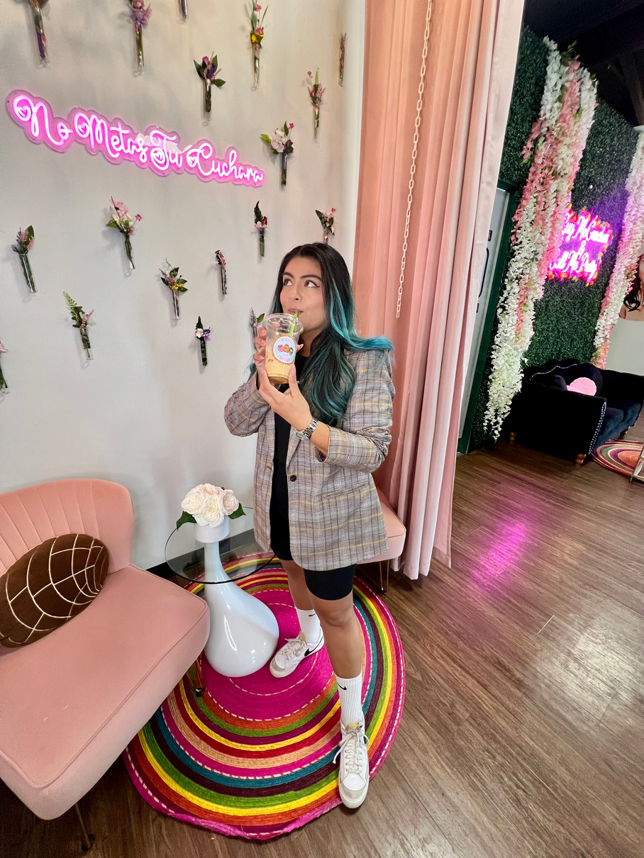
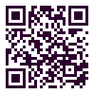
THANK YOU
Remember to have fun because no one is YOUER than YOU!!!!
Erika Finnestead

